Slide 1
Deep Portfolio Theory
Presented by: Jinyang Li; Linda Wu; Lina Wang
ACTSC 972 Midterm Project

Slide 2
INTRODUCTION
OVERVIEW
Deep portfolio theory builds on Markowitz’s classic risk-return trade-off and makes use of deep learning to construct portfolios.
It first encodes the market information and then decodes it to form a portfolio that is designed to achieve the goal.
It relies on deep factors which have a non-linear relationship to the input data.
Primary strength: avoid any statistical inputs such as expected returns or variance-covariance matrices.
Objective: It will formulate an automated and general portfolio selection process (4 steps): Auto-Encoding; Calibration; Validation; Verification.

Slide 3
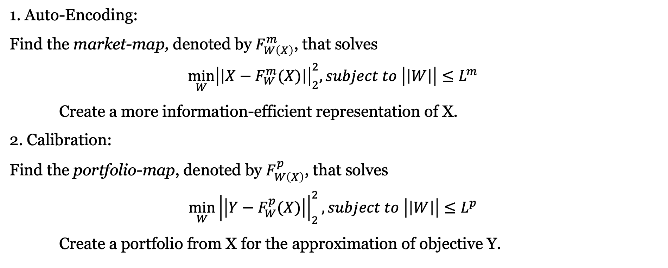
INTRODUCTION
4 STEPS
1. Auto-Encoding:
Find the market-map, denoted by $F_{W\left(X\right)}^{m}$, that solves
$$\min_{W}{{\left|\left|X−F_{W}^{m}(X)\right|\right|}_{2}^{2}, subject to \left|\left|W\right|\right|≤L^{m}}$$
Create a more information-efficient representation of X.
2. Calibration:
Find the portfolio-map, denoted by $F_{W\left(X\right)}^{p}$, that solves
$$\min_{W}{{\left|\left|Y−F_{W}^{p}(X)\right|\right|}_{2}^{2}, subject to \left|\left|W\right|\right|≤L^{p}}$$
Create a portfolio from X for the approximation of objective Y.

Slide 4
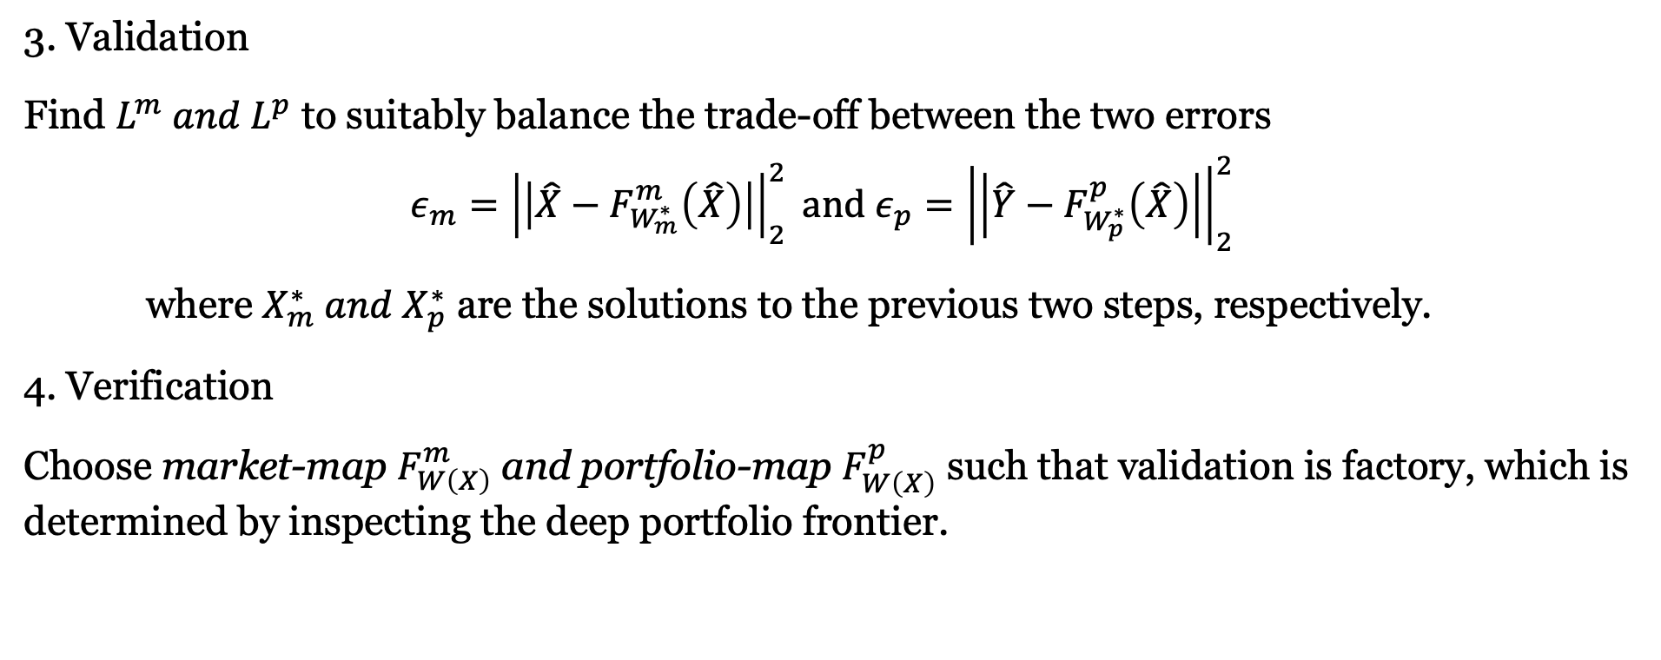
INTRODUCTION
4 STEPS
3. Validation
Find $L^{m} and L^{p}$ to suitably balance the trade-off between the two errors
$$ε_{m}={\left|\left|\hat{X}−F_{W_{m}^{∗}}^{m}\left(\hat{X}\right)\right|\right|}_{2}^{2} and ε_{p}={\left|\left|\hat{Y}−F_{W_{p}^{∗}}^{p}\left(\hat{X}\right)\right|\right|}_{2}^{2}$$
where $X_{m}^{∗} and X_{p}^{∗}$ are the solutions to the previous two steps, respectively.
4. Verification
Choose market-map $F_{W\left(X\right)}^{m}$ and portfolio-map $F_{W\left(X\right)}^{p}$ such that validation is factory, which is determined by inspecting the deep portfolio frontier.

Slide 5
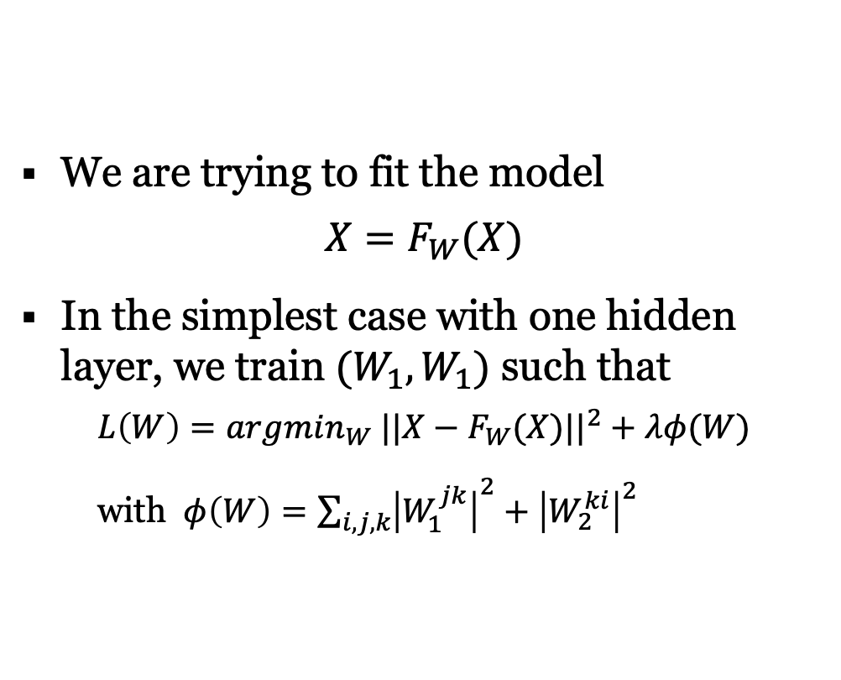
Introduction – Auto encoder
ARCHITECTURE
We are trying to fit the model
$$X=F_{W}(X)$$
In the simplest case with one hidden layer, we train $(W_{1},W_{1})$ such that
$$L\left(W\right)=argmin_{W} ||X−F_{W}(X)||^{2}+λφ(W)$$
with $φ\left(W\right)=\sum_{i,j,k}{{\left|W_{1}^{jk}\right|}^{2}+{\left|W_{2}^{ki}\right|}^{2}}$

Slide 6
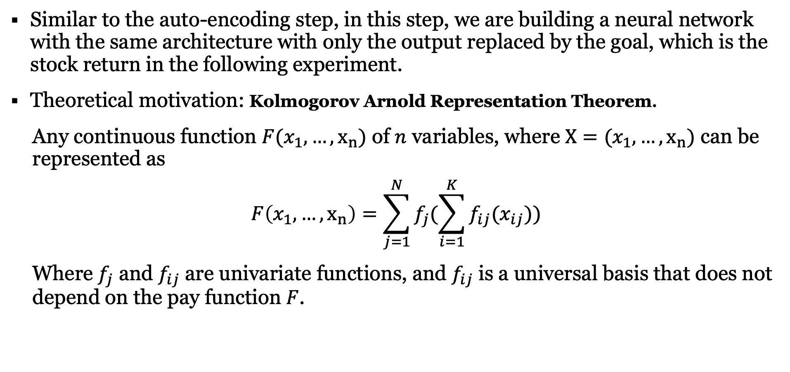
Introduction – traditional factor models
ARCHITECTURE
Similar to the auto-encoding step, in this step, we are building a neural network with the same architecture with only the output replaced by the goal, which is the stock return in the following experiment.
Theoretical motivation: Kolmogorov Arnold Representation Theorem.
Any continuous function $F(x_{1},…,x_{n})$ of $n$ variables, where $X=(x_{1},…,x_{n})$ can be represented as
$$F\left(x_{1},…,x_{n}\right)=\sum_{j=1}^{N}{f_{j}(\sum_{i=1}^{K}{f_{ij}(x_{ij})})}$$
Where $f_{j}$ and $f_{ij}$ are univariate functions, and $f_{ij}$ is a universal basis that does not depend on the pay function $F$.

Slide 7
NUMERICAL EXPERIMENT
The paper has retraced the IBB Index as an numerical example. The goal is to find a small selection of stocks for which a deep portfolio structure with good out-of-sample tracking properties can found.
In our project, we are retracing the IVW Index by applying the deep portfolio theory.
IVW tracks an index of large-cap US stocks. The index selects stocks with growth characteristics from the S&P 500 Index.
Number of holdings as of 10/29/2019: 297 stocks
We have successfully replicated the four steps in the paper with satisfing result achieved, with each step being discussed in detail one by one next.

Slide 8
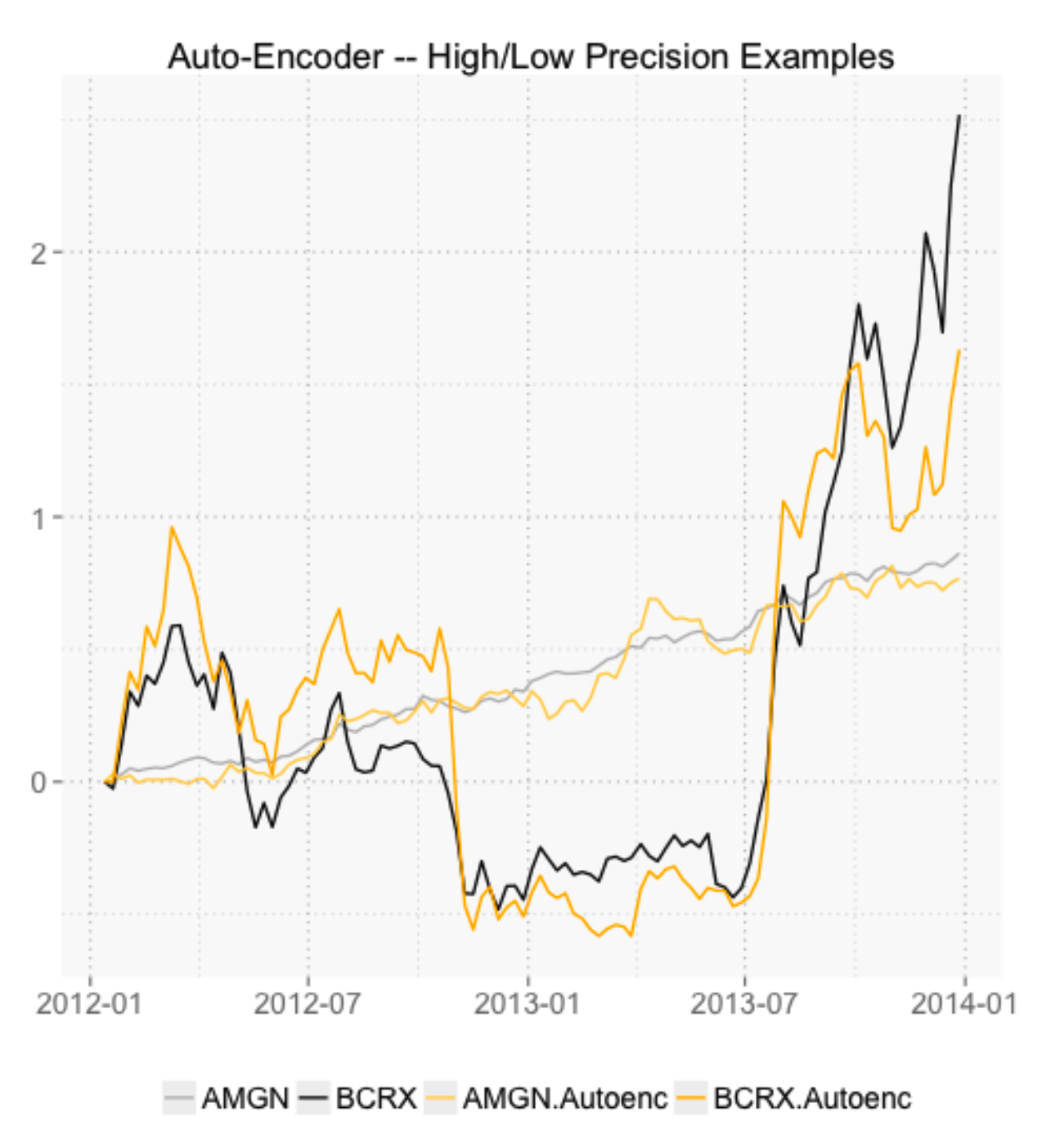
Auto-Encoding

Slide 9
REFERENCE

Slide 10
Thanks for listening

